Slide 1




PIZZA SALES REPORT

Slide 2

About Me
Pizza is a popular food enjoyed by people all over the world. It started in Italy and is now loved by many. Selling pizza is a big part of the food business, with both small pizza shops and big chains competing.
This project involves using a database for Pizza Hut, where different SQL queries help analyze pizza sales. The tasks include counting the total number of orders, figuring out the total money made from pizza sales, finding the most expensive pizza, and identifying the most common pizza size ordered. The project also looks into more detailed queries, such as checking revenue by pizza category, tracking revenue over time, and finding the top pizza types based on money earned. The goal is to understand sales trends and what customers prefer.

Slide 3

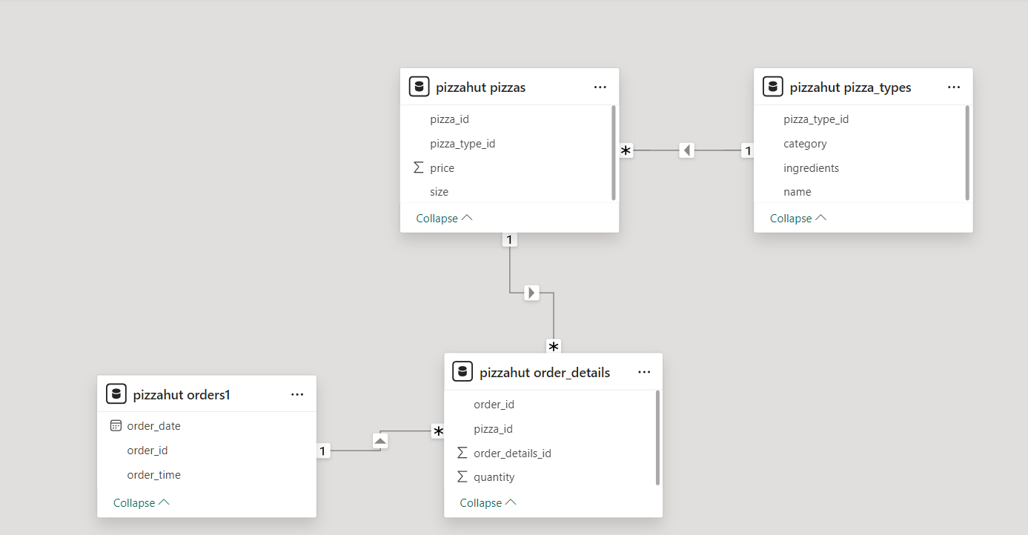

Schema

Slide 4
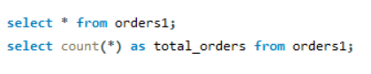


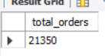
Find total number of pizza orders placed

Slide 5
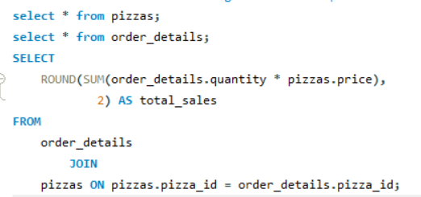

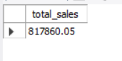
Calculate total revenue generated from pizza sales

Slide 6
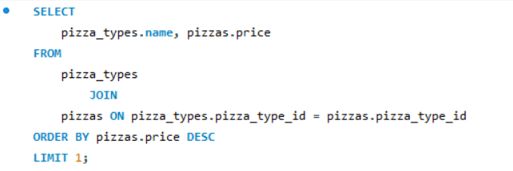

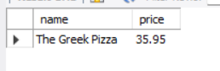
Identify the highest price pizza.

Slide 7
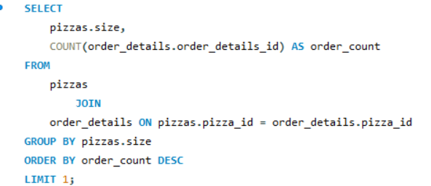

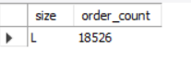
Find most common pizza size ordered.

Slide 8
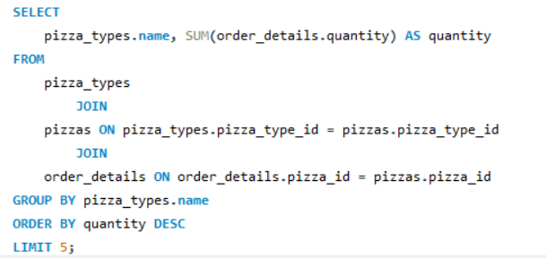
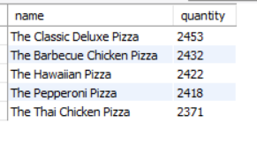
Top 5 most ordered pizza types along with their quantities.

Slide 9
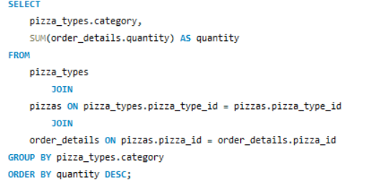
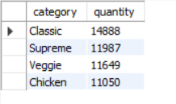
Find the total quantity of each pizza category ordered.

Slide 10
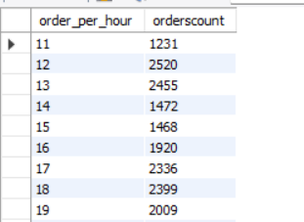
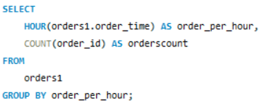
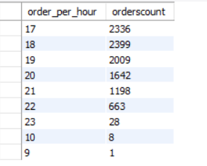
Determine the distribution of orders by hour of the day.

Slide 11
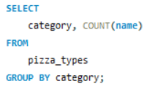
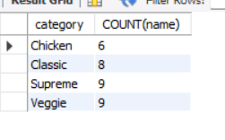
Find the category_wise distribution of pizzas.

Slide 12
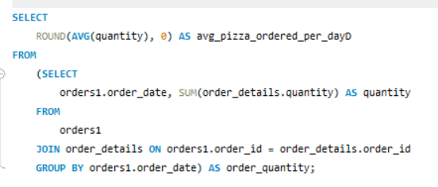
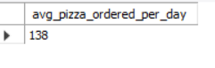
Group the orders and date and calculate the average number of pizzas ordered per day.

Slide 13
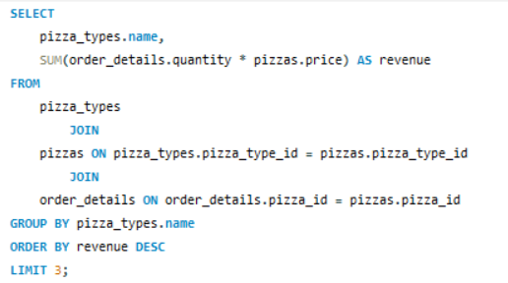
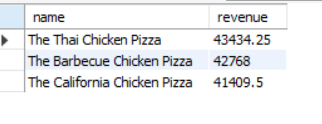

Top 3 most ordered pizzas types based on revenue

Slide 14
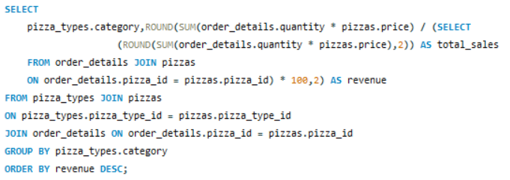
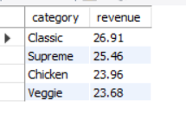
Calculate the percentage contribution of each pizza type to total revenue based on category

Slide 15
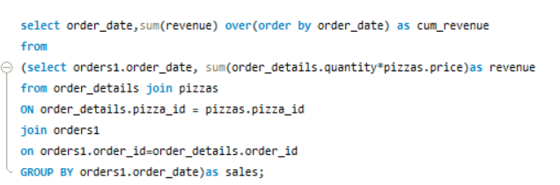
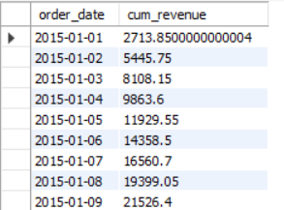

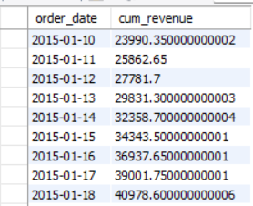

Analyze the cumulative revenue generated over time.

Slide 16
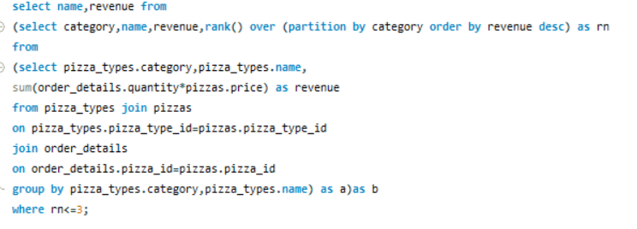
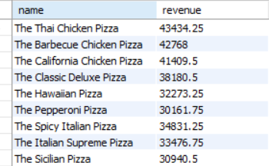
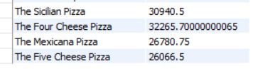


The top 3 most ordered pizza types based on revenue for each pizza category.

Slide 17
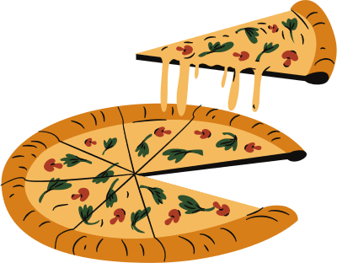

Conclusion
In conclusion, these SQL queries give a clear picture of Pizza Hut's sales data. They start with basic details like the total number of orders and overall revenue. The queries then look at specific aspects like the most expensive pizza, the most popular pizza size, and the top pizza types ordered. They also check how orders are spread throughout the day, how pizzas are distributed by category, and the average number of pizzas ordered daily. More advanced queries show how much revenue each pizza category brings in, track revenue growth over time, and list the top pizza types by revenue in each category. Together, these queries help understand sales trends, what customers like, and revenue patterns, which helps in making better business decisions.

Slide 18
PIZZA PARTY!

